Slide 1
Designing BMS-8 derivatives

Slide 2
Class structure
Year-long “professional skills” module
1/6 year CP
Class runs as a mock-CRO in groups of 4-6 students
Orientation / skills
Computational labs
Synthesis
Presentation
www.ntu.ac.uk

Slide 3
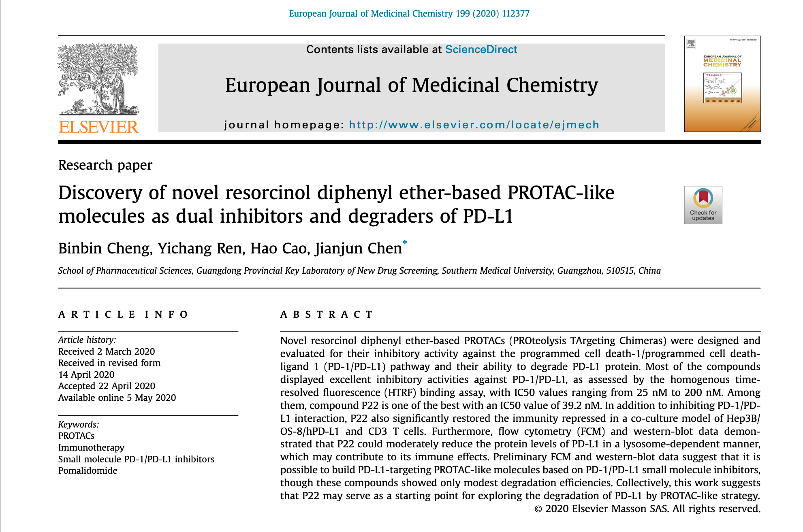
Starting Point:
Cheng, B.; Ren, Y.; Cao, H.; Chen, J.; Eur. J. Medic Chem 199, 112377 (2020)
www.ntu.ac.uk

Slide 4
Starting Point: BMS-8
Cheng, B.; Ren, Y.; Cao, H.; Chen, J.; Eur. J. Medic Chem 199, 112377 (2020)
www.ntu.ac.uk

Slide 5
First, look at the patent
https://patentimages.storage.googleapis.com/8e/90/01/6780a23a19f23b/WO2015034820A1.pdf
BMS-n
Identify parts of the molecule that change, and get first look at a possible synthesis procedure
www.ntu.ac.uk

Slide 6
Starting Point: BMS-8
Cheng, B.; Ren, Y.; Cao, H.; Chen, J.; Eur. J. Medic Chem 199, 112377 (2020)
www.ntu.ac.uk

Slide 7
Starting Point: BMS-8
Cheng, B.; Ren, Y.; Cao, H.; Chen, J.; Eur. J. Medic Chem 199, 112377 (2020)
www.ntu.ac.uk

Slide 8
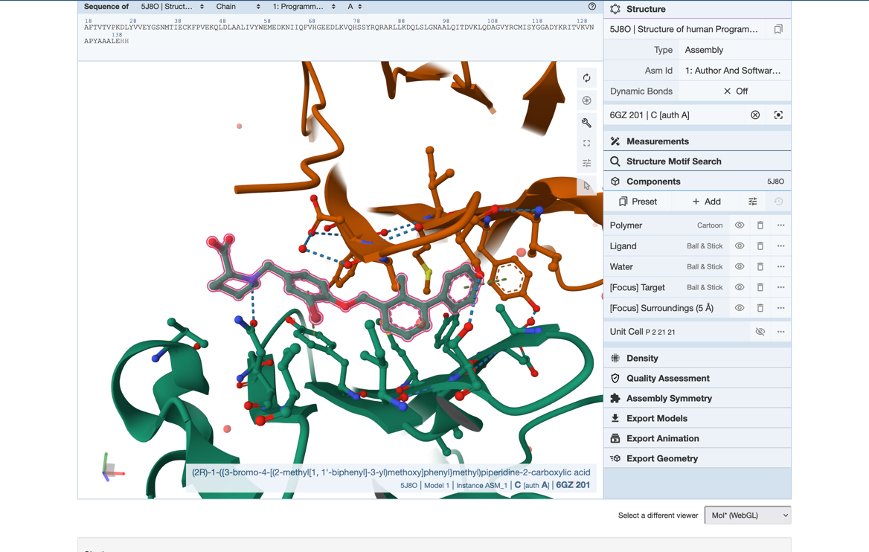
Starting Point: 5J8O (BMS-8 @PD-L1)
www.ntu.ac.uk

Slide 9
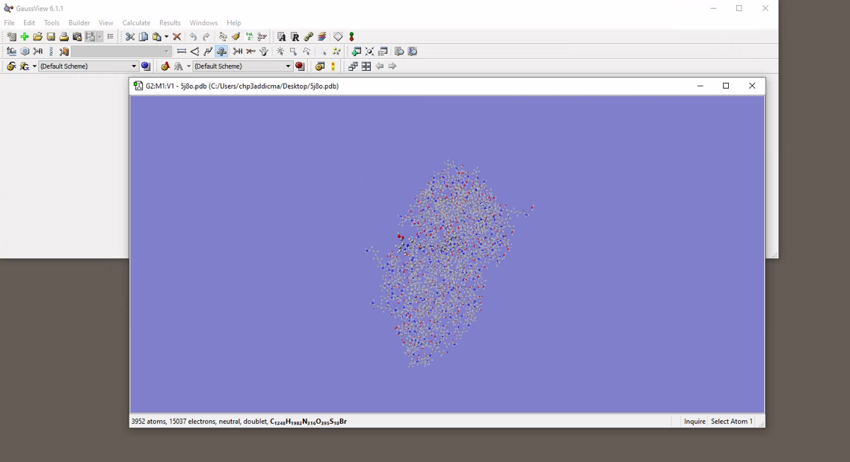
Starting Point: 5J8O (BMS-8 @PD-L1)
www.ntu.ac.uk

Slide 10
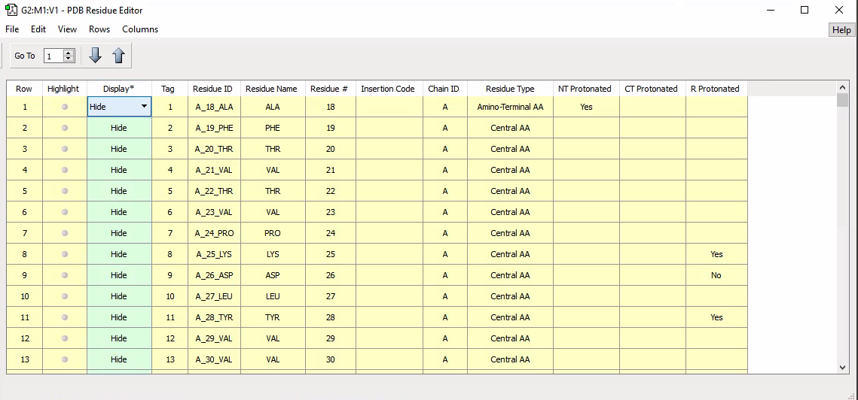
Starting Point: 5J8O (BMS-8 @PD-L1)
www.ntu.ac.uk

Slide 11
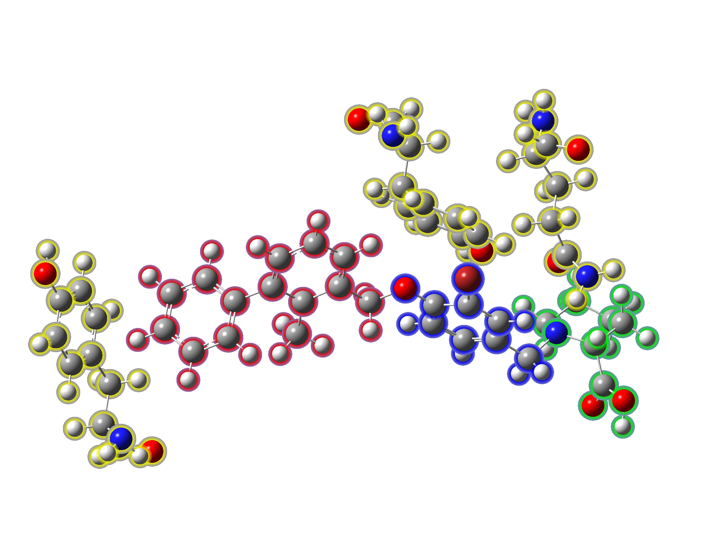
BMS-8 with immediate residues
www.ntu.ac.uk

Slide 12
Now we get to some calculations…
Single-point PM6
Binding energies:
Overall
Per interaction (2 pi-stacks and 1 hydrogen bond)
www.ntu.ac.uk

Slide 13
Derivatives
Look (again) at the BMS patent for inspiration
Partial optimization
Fixed-position residues
Optimized BMS-n
Re-calculate binding energies:
What drug-protein interactions change (pi-stacks, hydrogen bond)
How does this link to a synthesis plan?
www.ntu.ac.uk

Slide 14
Acknowledgements
Dr Emma Smith
Dr Chris Garner
Dr Warren Cross
Dr Ray Leslie
www.ntu.ac.uk

