Slide 1
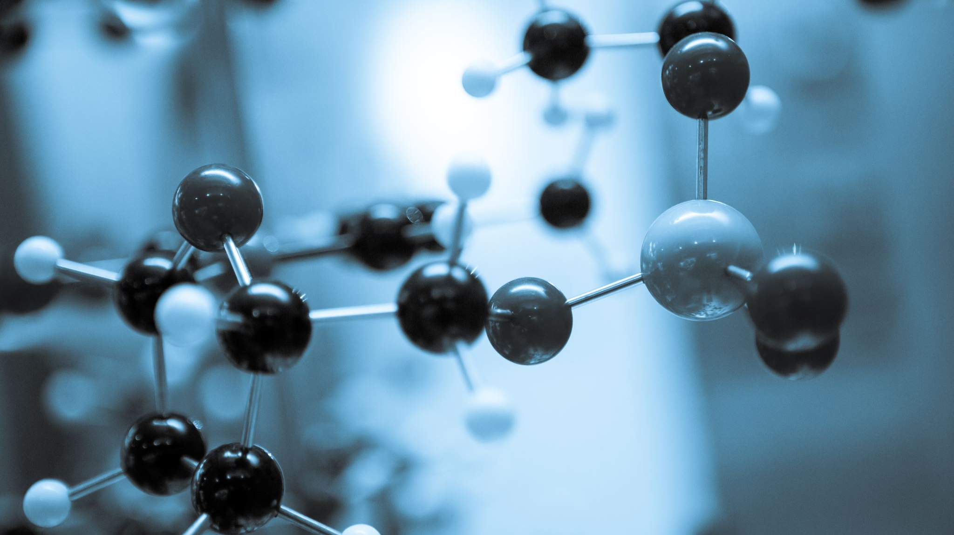
Teaching Structure-Based Drug Discovery Through a Guided Molecular Docking Workflow
Isabela Santos de Melo Wiermann
PhD Student – Federal University of São João del-Rei, Brazil

Slide 2


The Guided Docking Module: A Concept-Driven Approach
Students often encounter molecular recognition and protein structure in isolation. This module bridges that gap.
2–3 hour structured session
Upper-level undergraduate / early graduate
Emphasis on analytical reasoning
Implemented using open-access tools
Framework adaptable to Schrödinger softwares

Slide 3
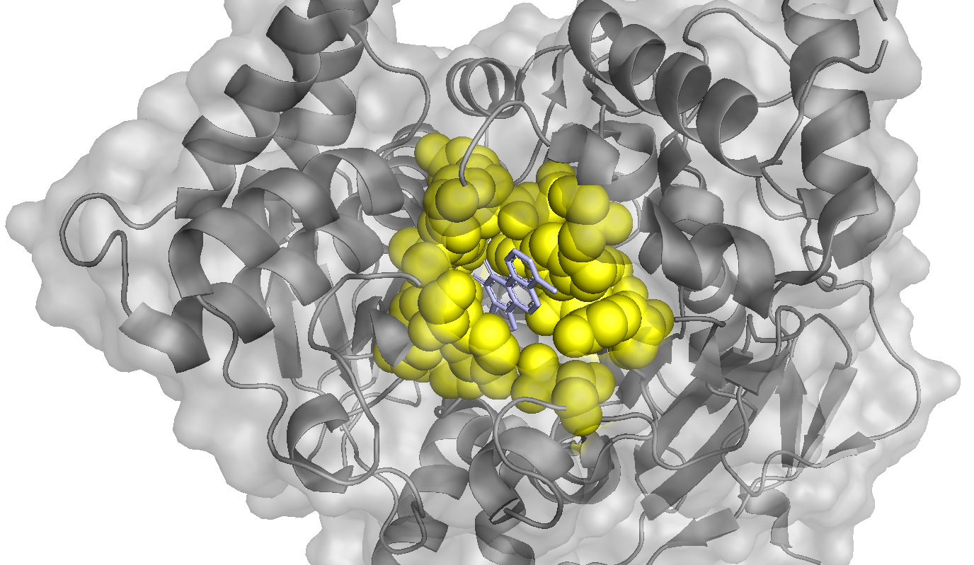
Structural Analysis (AChE - PDB: 4M0E)
Deep aromatic cavity
Crystallographic ligand as structural reference
Students identify the interactions in this native complex

Slide 4
Docking Setup: Protein and Ligand Preparation
Chain A retained
Waters and non-relevant heteroatoms removed
Ligands and protein are prepared
Structures converted to PDBQT format

Slide 5
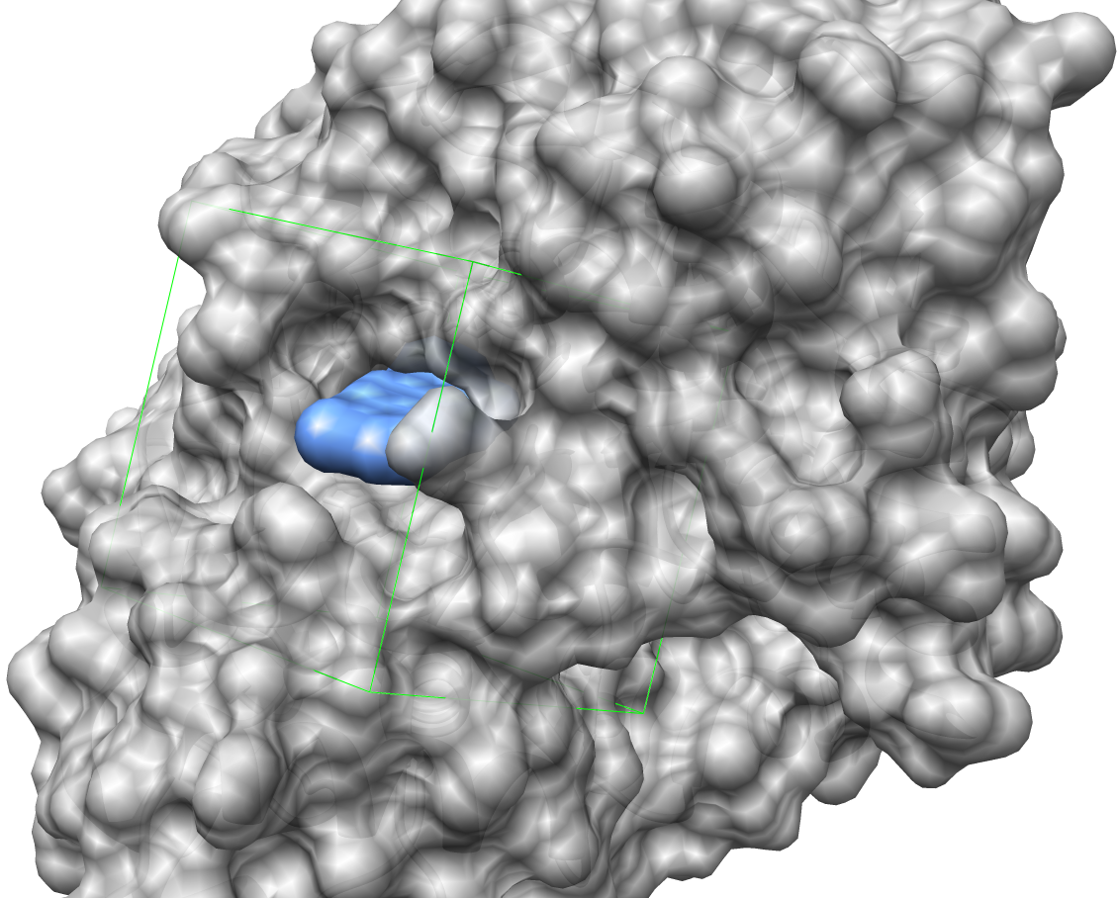
Docking Setup: Grid Definition
Grid centered on crystallographic binding site
Encompasses aromatic binding cavity
Identical parameters used for validation and prediction

Slide 6
Docking Execution
Platform-independent workflow
Autodock Vina (open-access implementation)
Standardized search space
Consistent exhaustiveness parameter

Slide 7
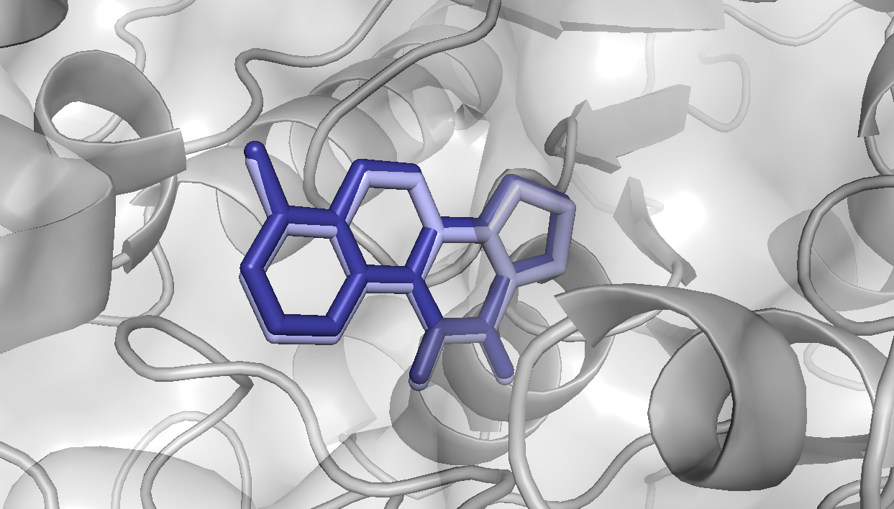
Protocol Validation Through Redocking
RMSD = 0.219 Å
< 2.0 Å: Successful reproduction
Validates protocol consistency, not predictive certainty for new ligands

Slide 8
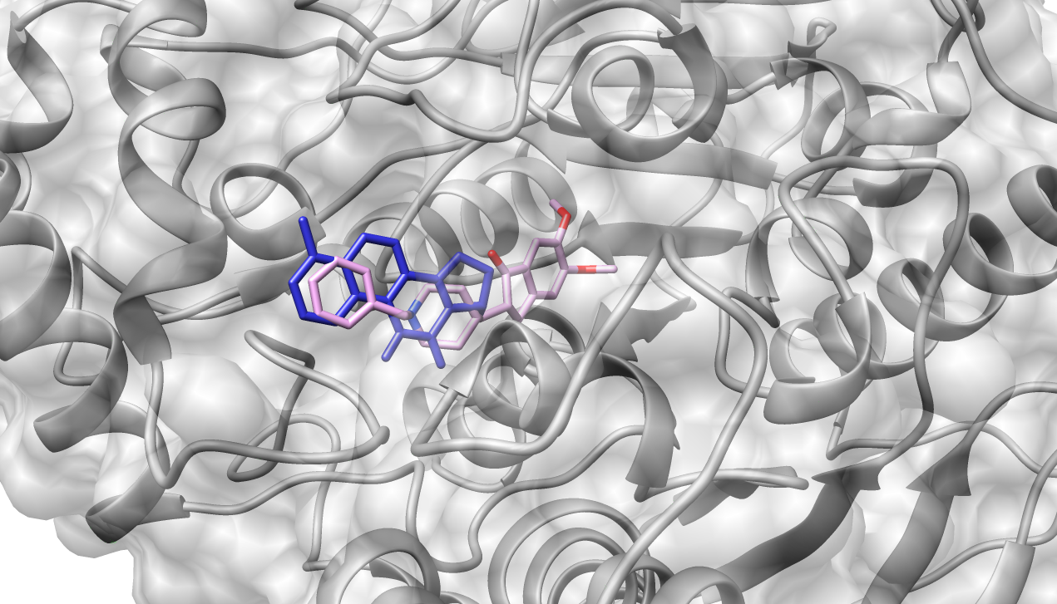
Predictive Docking: Comparative Evaluation
Ligand | Vina score (kcal/mol)
1YL | -11.99
Donepezil | -9.50
Score ≠ biological efficacy

Slide 9
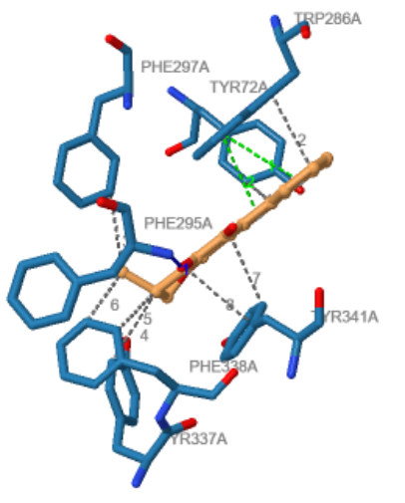
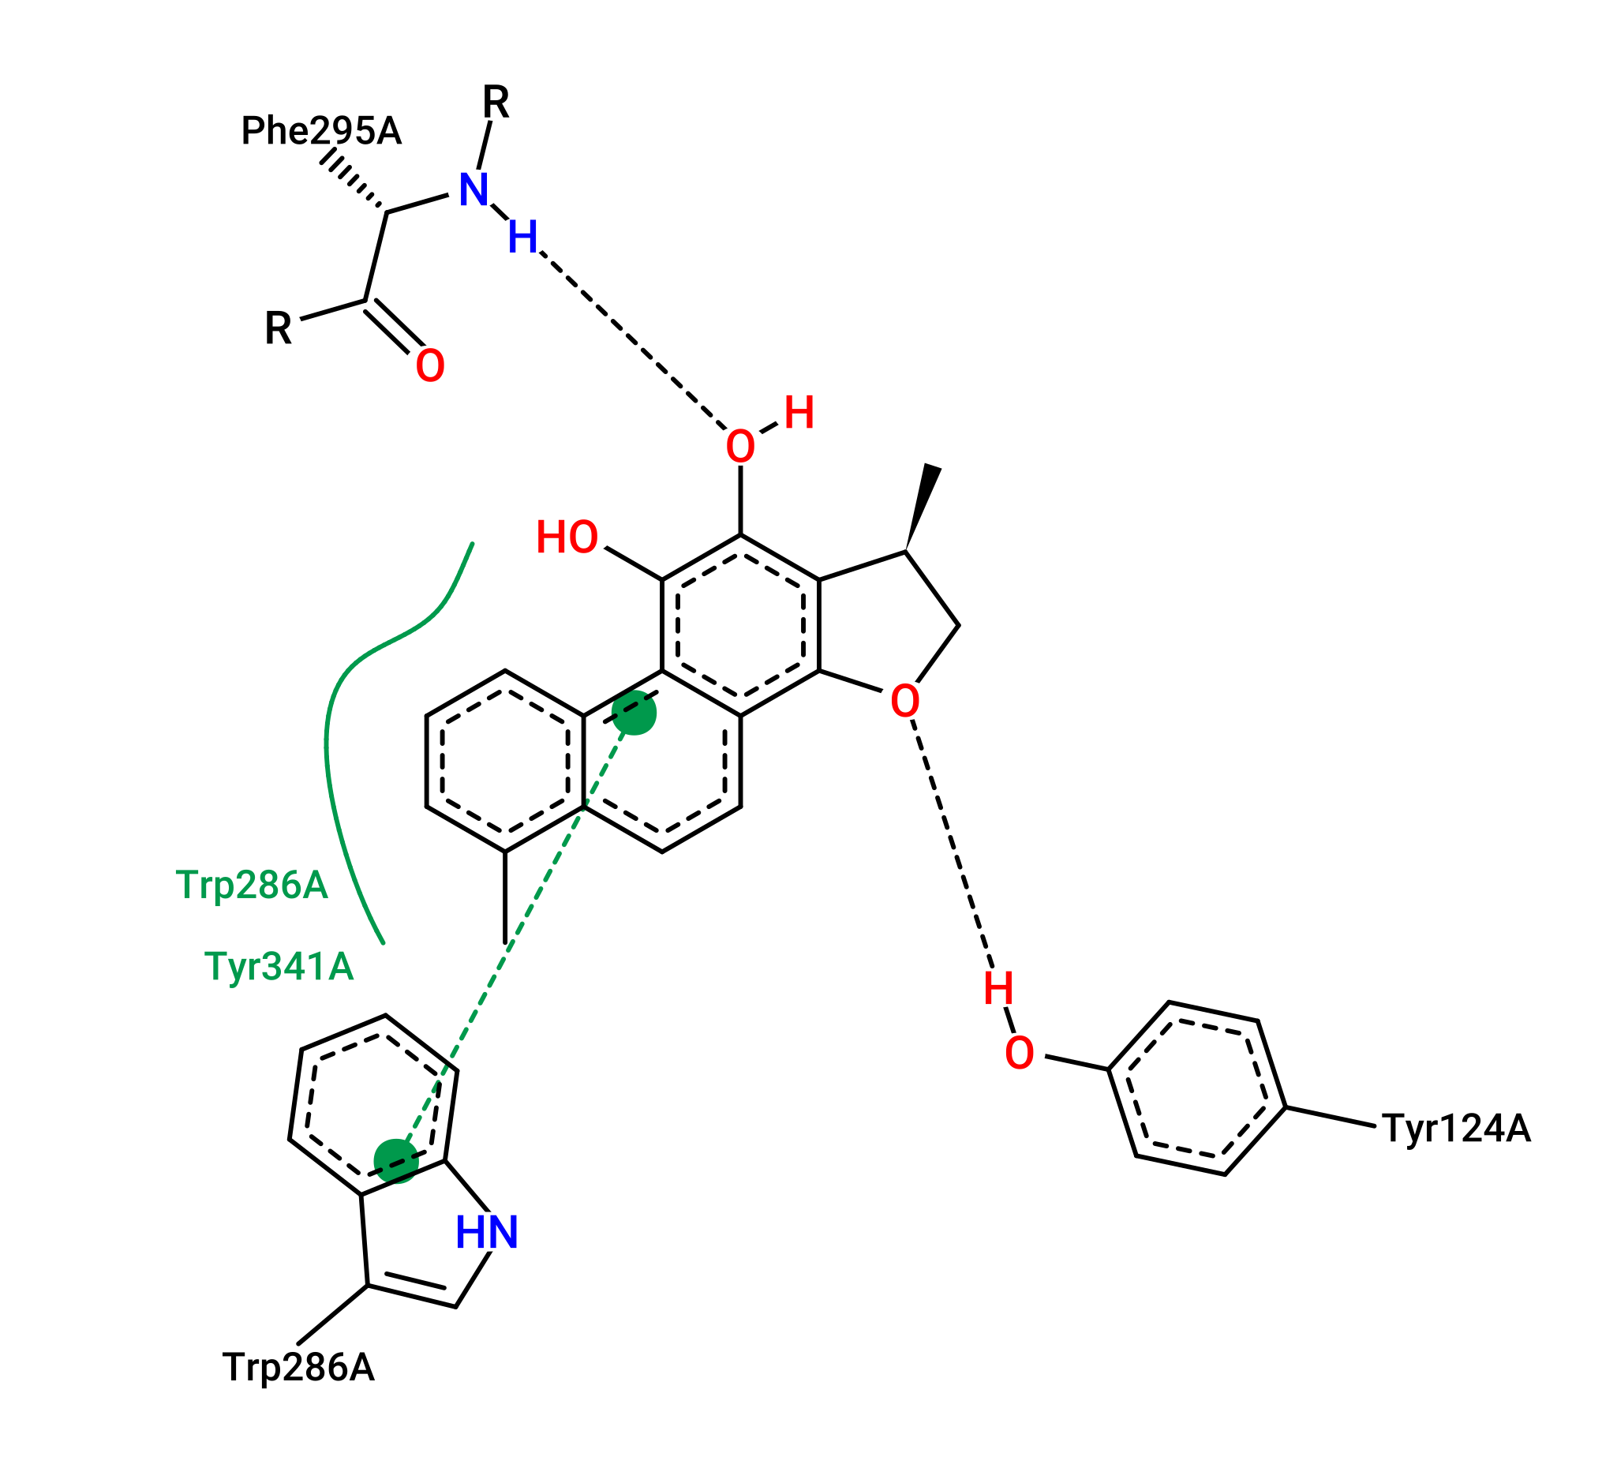
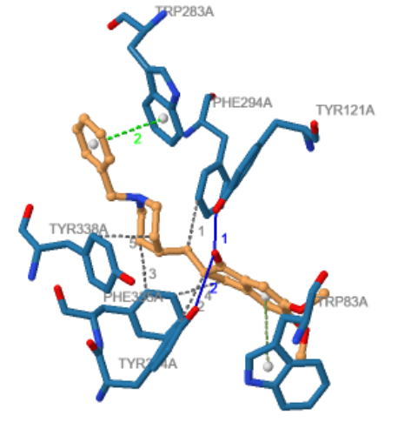
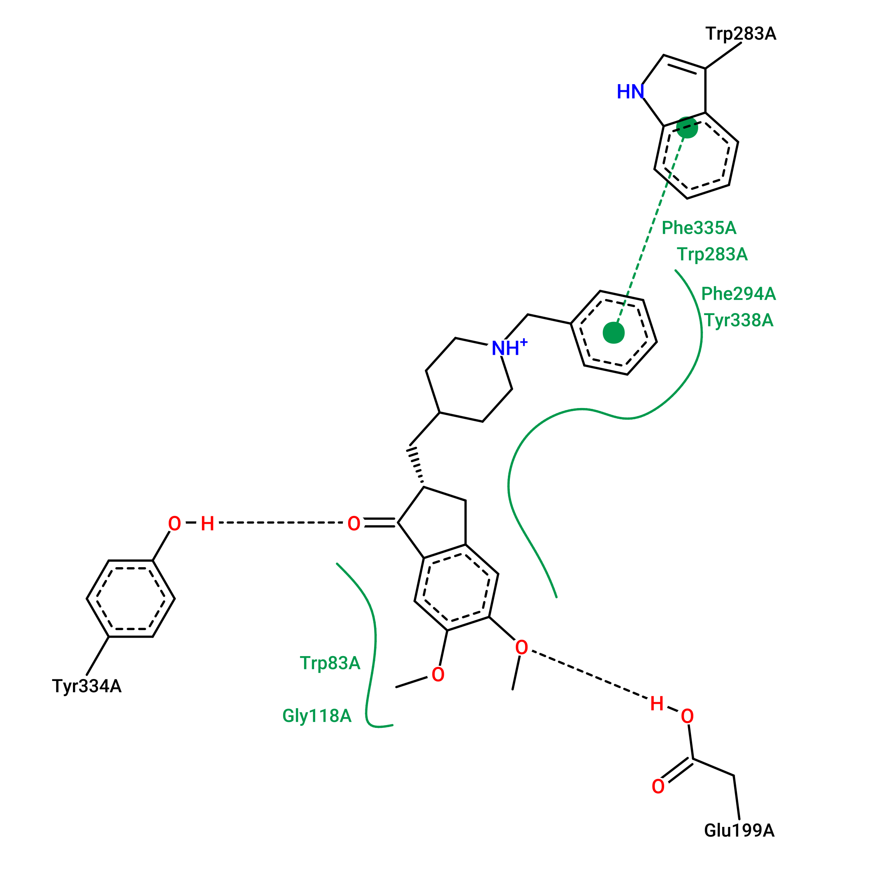
Comparative Interaction Analysis
1YL (crystallographic ligand)
Donepezil

Slide 10
Critical Reflection and Methodological Considerations
Limitations
Rigid-receptor docking
Scoring function assumptions
Risk of false positives
Docking is probabilistic modeling
not definitive proof of binding.

Slide 11
Implementation-Ready Teaching Package
Prepared receptor & ligand files
Configuration files
Docking outputs
High-resolution figures
Detailed instructional guide
Structured worksheet for analytical discussion
2-3 hour structured delivery
Tools: UCSF Chimera, PyMOL, Open Babel, AutoDock Vina

Slide 12



Thank you for your attention!
Contact information:
LinkedIn
E-mail

