Slide 1
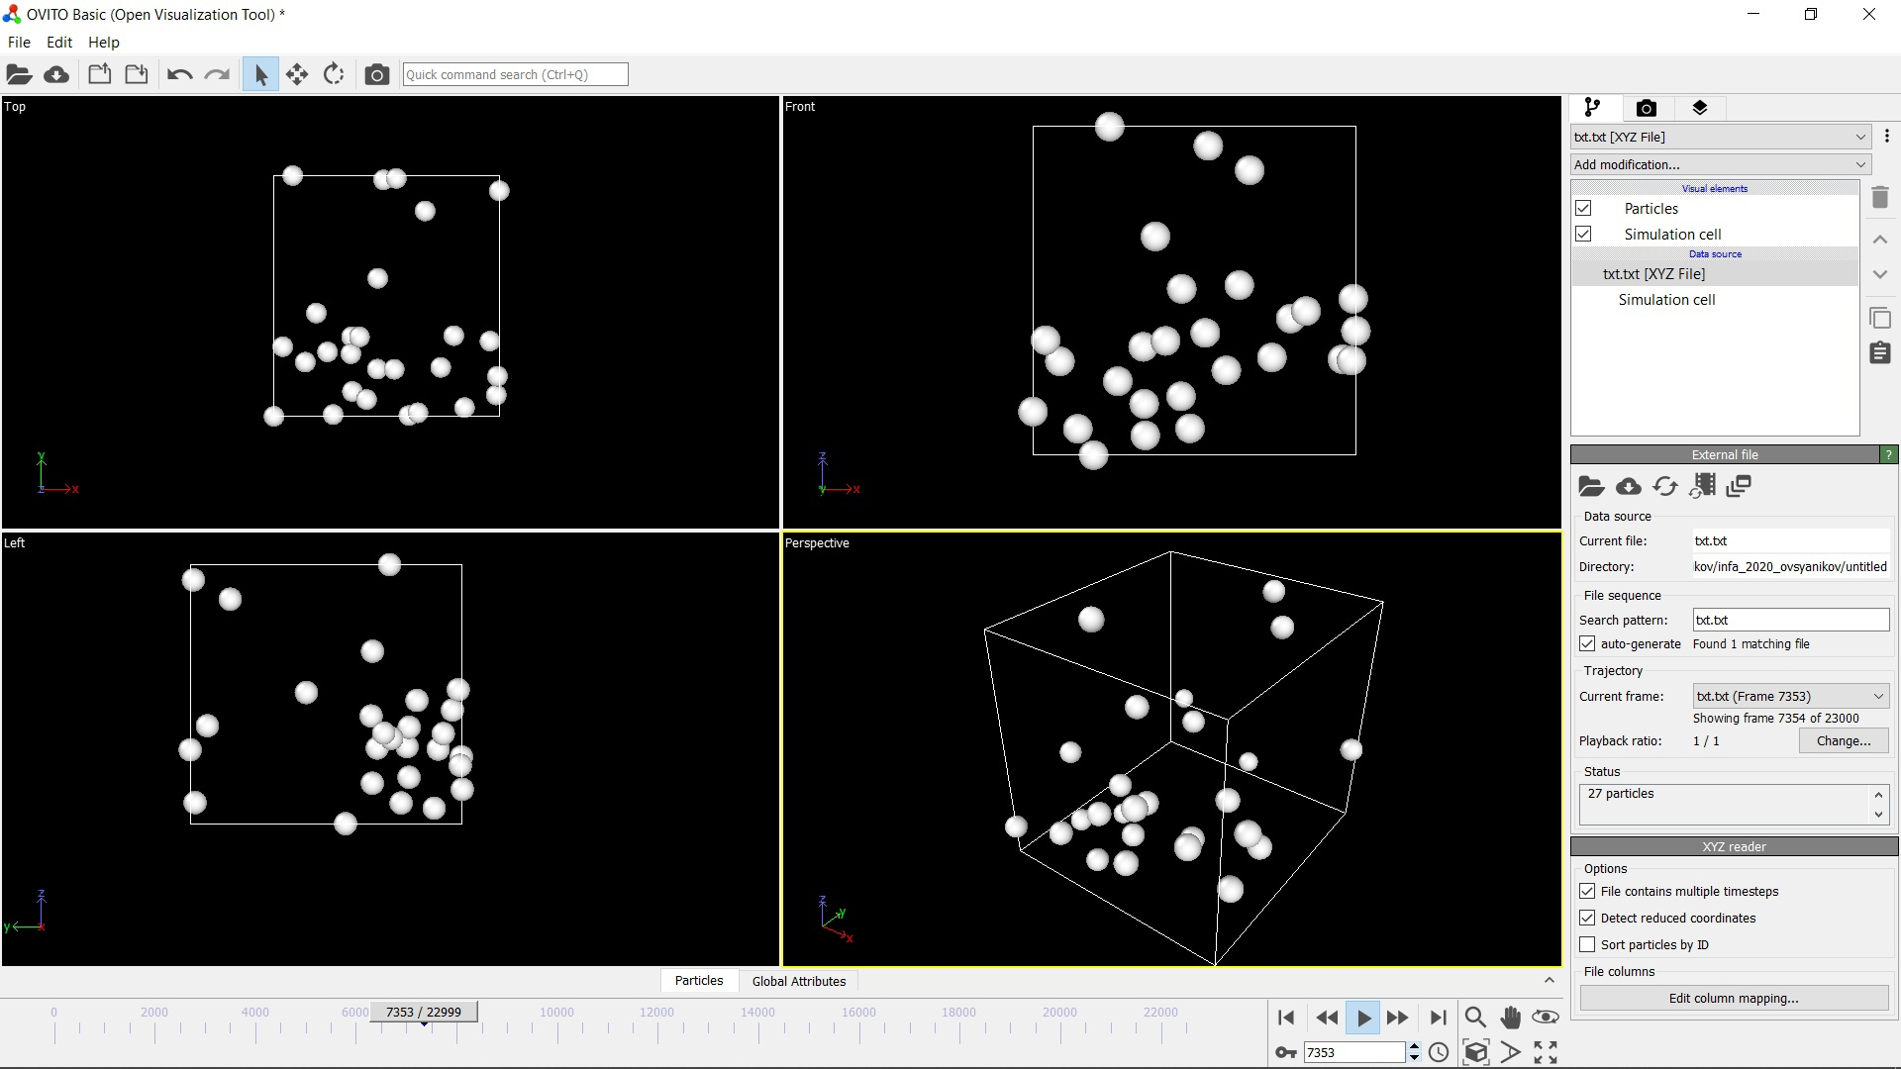
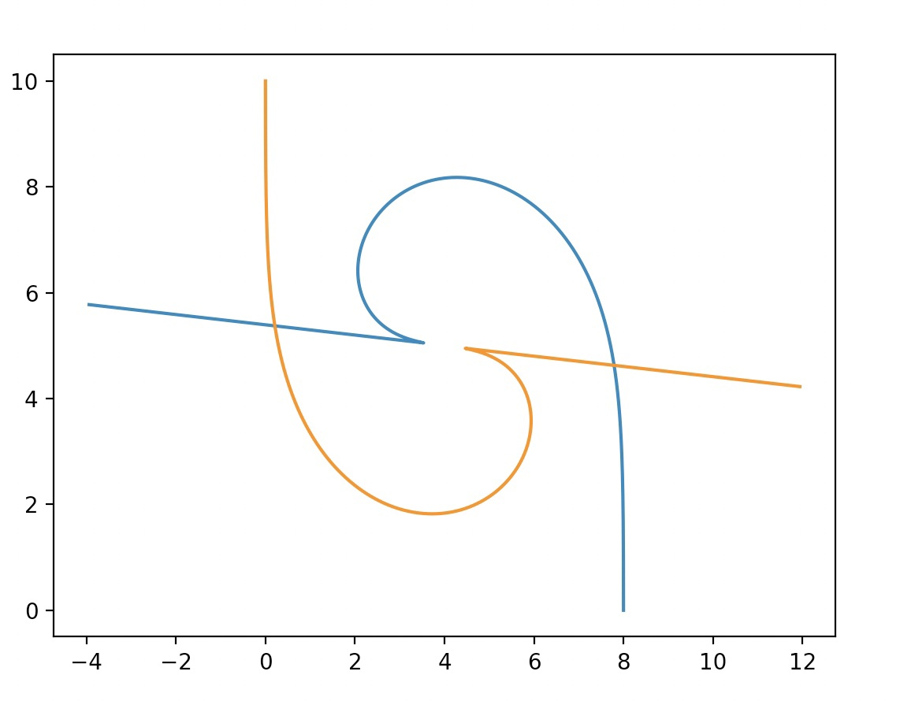
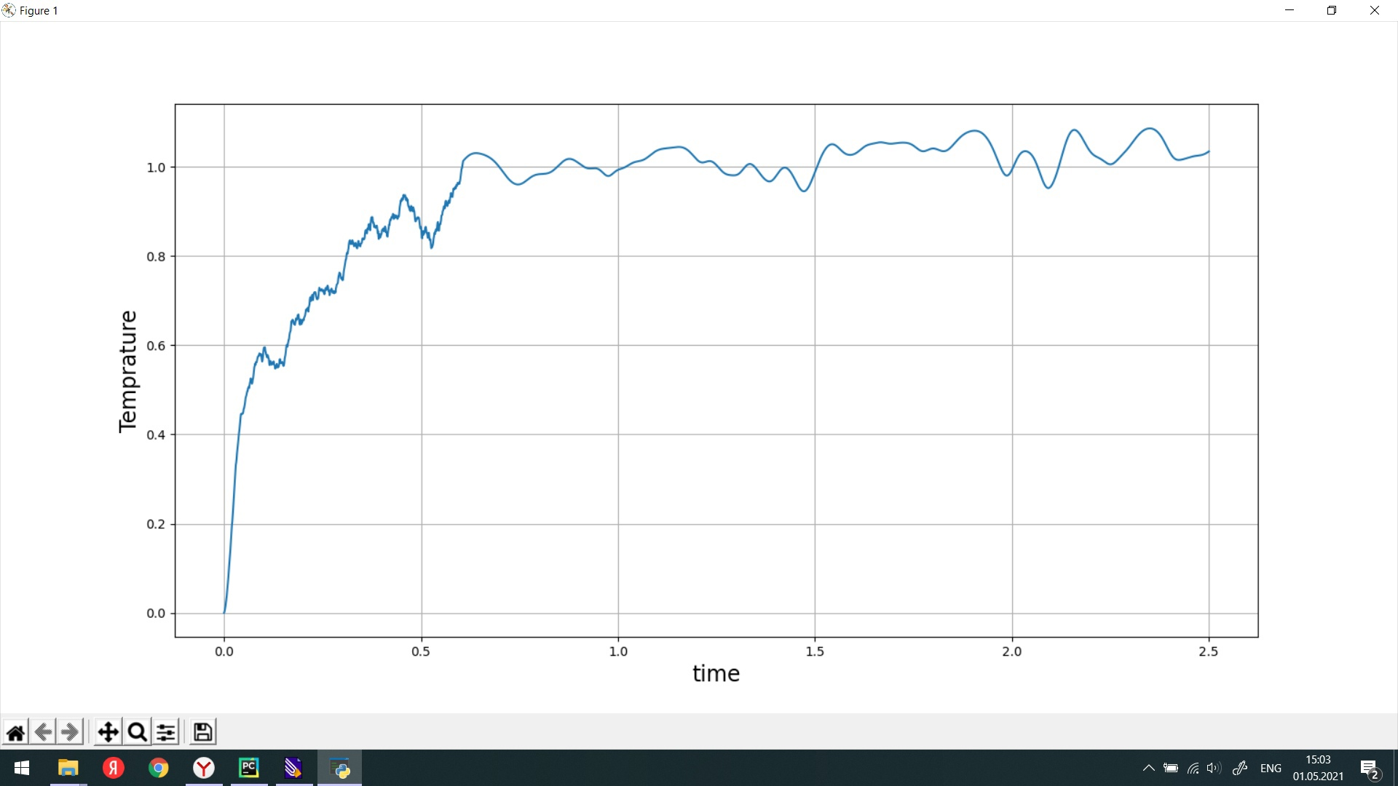
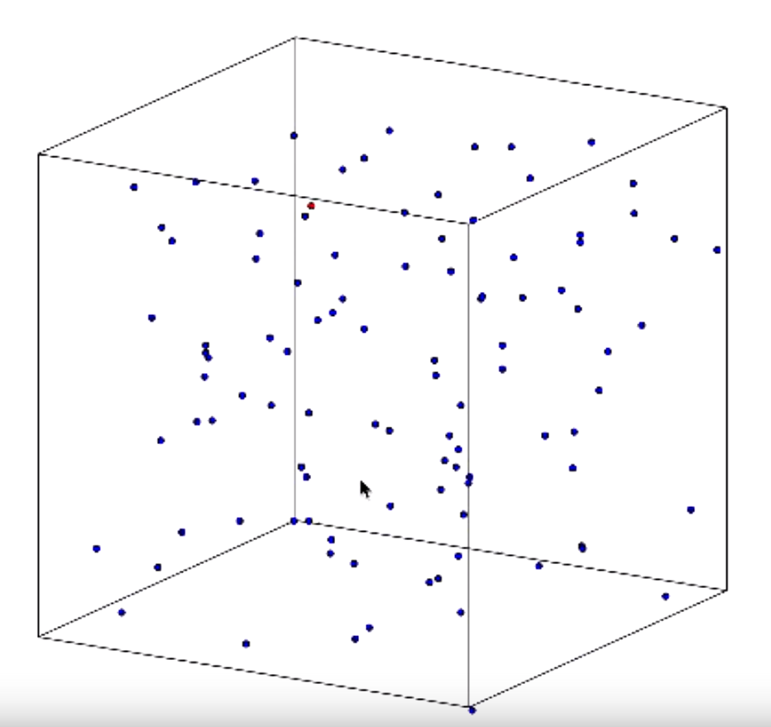
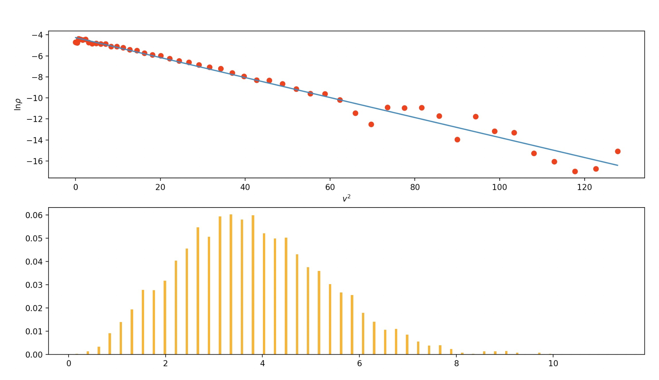
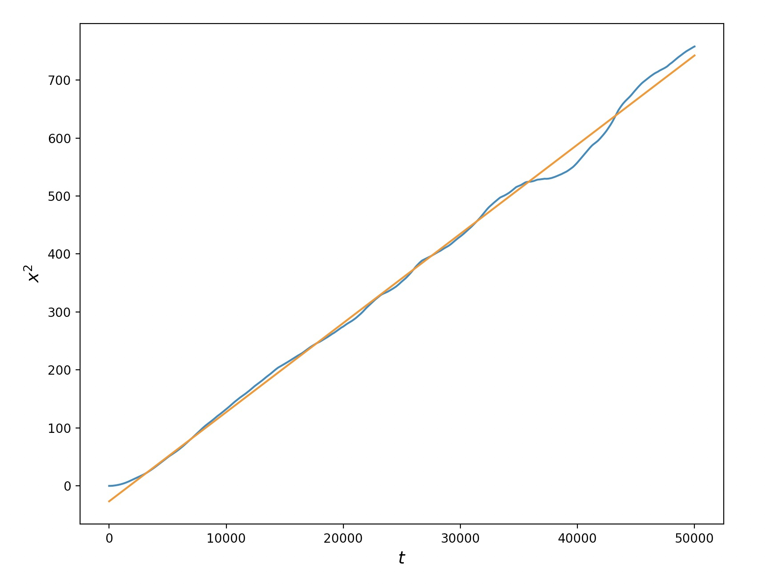
Molecular Dynamics fundamentals and applications minicourse
Yury Polyachenko
04.28.2026

Slide 2

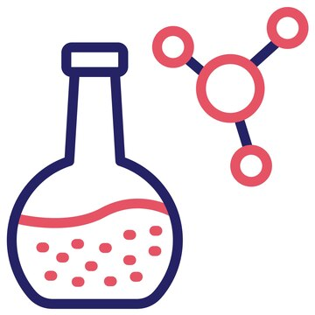
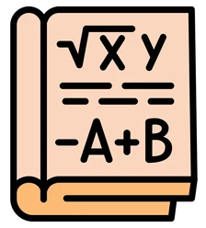


The reasons I do this
I enjoy working with student who willingly give their “free” time to work on science questions we both find exciting - this definitely gives me energy
2) I was mentored myself, and it helped to see why we were taught many ____things in courses + give hopes all these theory can be useful to people

Slide 3
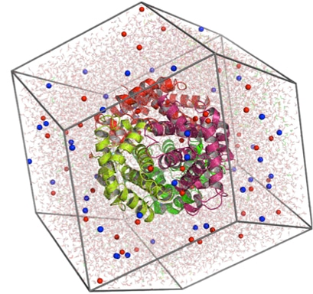
The reasons I do this
I enjoy working with student who willingly give their “free” time to work on science questions we both find exciting - this definitely gives me energy
2) I was mentored myself, and it helped to see why we were taught many ____things in courses + give hopes all these theory can be useful to people

Slide 4

The reasons I do this
I enjoy working with student who willingly give their “free” time to work on science questions we both find exciting - this definitely gives me energy
2) I was mentored myself, and it helped to see why we were taught many ____things in courses + give hopes all these theory can be useful to people
drugs
plastics
batteries
chip manufacturing

Slide 5
The reasons I do this
I enjoy working with student who willingly give their “free” time to work on science questions we both find exciting - this definitely gives me energy
2) I was mentored myself, and it helped to see why we were taught many ____things in courses + give hopes all these theory can be useful to people
drugs
plastics
batteries
chip manufacturing

Slide 6
My solution:
Introduce freshmen (and any other enthusitsts) to molecular simulations, why it’s cool, why it’s useful, and how to do it.
My approach: toy project to write MD from scratch, learn-by-doing
2020/1 (4th)
9 interested
2 hired
1 accepted to a summer LAMMPS workshop
2021/2 (5th)
5 interested
1 hired
2022/3 (G1)
14 interested
1 hired →
2 co-papers
3 co-APS-talks
2023/4 (G2)
10 interested
1 hired →
2 co-APS-talks
2024/5 (G3)
9 interested
1 hired →
Junior thesis
Senior thesis
2025/6 (G4)
11 interested
1 hired →
…

Slide 7
Toy project structure
Initial presentations (before they decide to invest their time)
First 1-2 lectures
Further meetings
Proceed to more serious research (if that’s the plan)

Slide 8
Toy project structure
Initial presentations (before they decide to invest their time)
First 1-2 lectures
Further meetings
Proceed to more serious research (if that’s the plan)

Slide 9
Toy project structure
Initial presentations (before they decide to invest their time)
First 1-2 lectures
Further meetings
Proceed to more serious research (if that’s the plan)

Slide 10
Toy project structure
Initial presentations (before they decide to invest their time)
First 1-2 lectures
Further meetings
Proceed to more serious research (if that’s the plan)

Slide 11
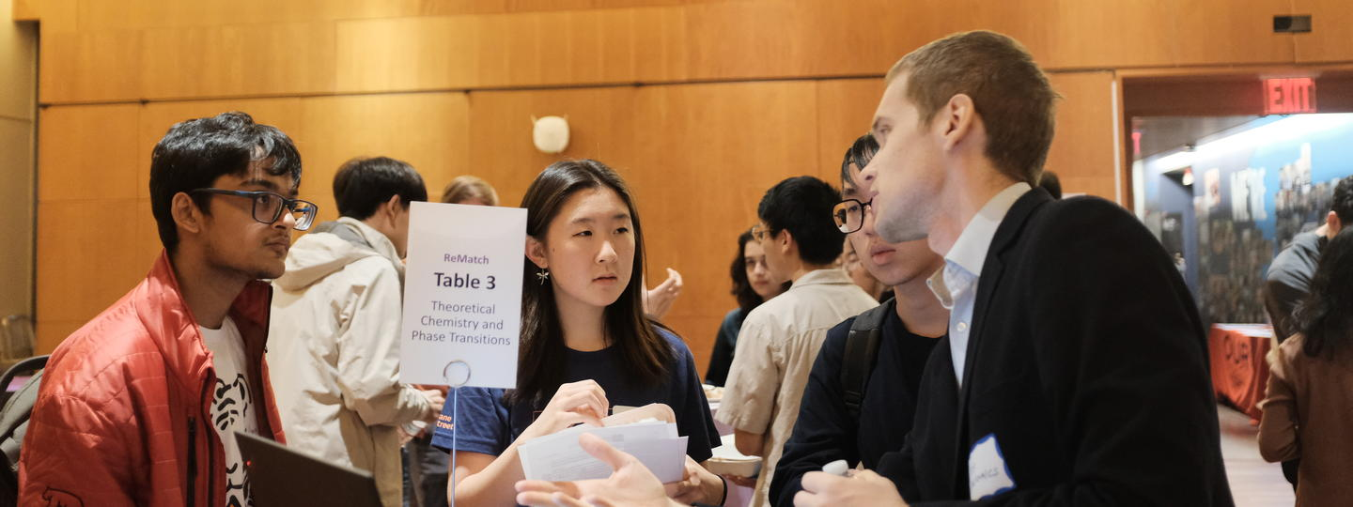
Initial presentations (before they decide to invest their time)
https://gradfutures.princeton.edu/forge-connections/rematch/effective-mentorship-skills-graduate-students

Slide 12
Initial presentations (before they decide to invest their time)
Often presentation are made in small groups:
ask the group about their background and interests
Background is often more important than “interests”, but use your judgement
Choose which topics/applications to pitch based on their background:
  Math/AI: conservation laws, 3-body problem, native symmetries in AI models
  CS/AI: GPU programming, alpha-fold, periodic labs
  Physics: non-ideal gas, real collisions, emergent properties like surface tension
  QM/Chem: bond-breaking reactions, electron clouds and DFT analogies
  Biology: MD protein models of springs, folding, coarse-grained examples, bacteria

Slide 13
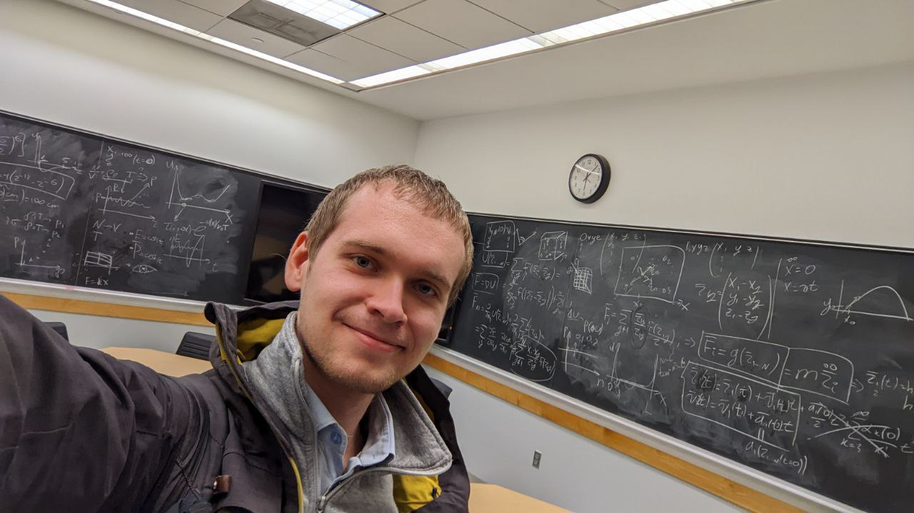
First 1-2 lectures (describing the project)
https://docs.google.com/document/d/1JTih8l5akEbNZtZ_yXat6Jgn8Qg1dwFWl5x03ULG-M0/edit?usp=sharing

Slide 14
First 1-2 lectures (describing the project)
1. Explain why spending their time working through this project will help them
To make sense of all the course-load (have a real system in mind for all subjects)
To enjoy the courses more, see the perspective, see ties between subjects
Why do this if open-source packages exist and AI can write using them?
  Ability to “debug” physical outcomes, combine your knowledge and expectations about the system with the understanding of math and numerics.
To have more practical (hirable) skills right at graduation
  Drug design (for bio/chem people, many small molecules to affect processes in your body)
    Binding (does the small molecule bind?)
    ADMET (how does the small molecule act before/after binding)
    Synthesisability (can we make the small molecule?)
  Material design (for physics people)
    Phase-transition temperatures, pressures (what the material will be like in our conditions?)
    Equation of state (how strong of a barrel do we need?)
    Equilibration kinetics (how long should we wait for a glue to harden?)
  Real companies like Schrodinger, Lam research, Pharma, bir tech ~Nvidia, Meta, Microsoft, …

Slide 15
First 1-2 lectures (describing the project)
2. Simulations as an approach when analytical models are not enough
Equation of state (for physics people)
  Ideal gas
  VdW gas
  Need even better? → MD
Proteins (for bio people)
  ligan binding
  conformational changes
Chemical reactions (for chem people)
  Proton transfer
  CH2 + 2O2 -> CO2 + 2H2O (cumbustion)

Slide 16
First 1-2 lectures (describing the project)
3. Physics of N interacting particles
Motivation for a classical MD level of approximation, and its applicability limitations
Physical assumptions to simplify from a general U(r_{1..n}) to Σ_{pairs} { u(r_{ij}) }
  Translational symmetry (as opposed to E-field)
  No 3-body effects (as opposed to H₂O)
  1 type of particles (as opposed to big-small)
  Rotational symmetry (as opposed to B-field + spin)
Going from a U(r_{1..n}) to forces (gradient) and then to equation of motion
  A note that the math results actually make sense - sum over all pair forces

Slide 17
First 1-2 lectures (describing the project)
4. Math of solving Newton 2nd law (dynamical systems)
Necessary parts of the problem: equation of motion + initial conditions
  A ball at an angle near the ground (constant force example)
  A rocket from Earth at an angle (space-dependent force)
  Our “abstract” 3ND equation of motion
Generating the initial state physically
  How to generate positions in a safe way?
  How to reasonably generate velocities?
The simplest (Euler) numerical scheme to solve any kind of equation of motion
  Ball
  Rocket
  A few example balls

Slide 18
First 1-2 lectures (describing the project)
5. Simulation-specific details
Natural units (on the SI vs LJ example)
  SI: m, s, kg
  We need 3 if we are not doing charges or other comre complex things
  But these 3 don’t have to be m, s, kg; E.g. can be m, J, kg.
  LJ: sgm, E, m
Boundary conditions and which to choose for which physical cases
  Reflective walls (a neat example)
  Repulsive walls (a real nano-box)
  Periodic (~bulk)
    Think about the closest image search

Slide 19
First 1-2 lectures (describing the project)
6. Expectations
Use the conditions N=100 particles, T=2.0 [LJ], ρ = 0.3 [LJ] (super-critical + dense for fast esuilibration)
Implement the initial state generation
Implement the force calculation and coordinate/velocity updating scheme (Euler by default, so they find energy non-conservation to realize it’s no default)
Using timestep dt = 0.001 [LJ], run for t_{final} = 10 [LJ]
Make a movie in Ovito (https://www.ovito.org/)
Plot E_{total}(t) (total energy = U+K) and P_{total, xyz}(t) (total momentum). Both should fluctuate but be approximately conserved

Slide 20
Possible extensions
Diffusion studies:
  Ballistic regime vs dissusive regime, transition region: derivation from Langevin + verification in MD
  Sutherland collision cross-section derivation and verification via MD
Different ways to choose R_{cut}
Pressure calculation
  Wall crossing counting
  Virial
  VdW equation of state verification
Equilibration studies:
  Maxwellization timescale
  Deviations from Maxwell at small N_particles
Numerical details:
  Velocity Verlet vs Euler vs RK4: reasons for VV stability
  Dynamical memory, sampling an NVE ensemble vs solving true dynamics
Developing a simple thermostat

